Slide 1




Rodrigo de Miguel Norwegian University of Science and Technology J. Miguel Rubí University of Barcelona (Spain) Steven Neshyba University of Puget Sound (USA)
Strong coupling,
vibrational frequency and
negatve thermophoresis
XXVII Sitges Conference on Statistical Mechanics
June 2023

Slide 2
(rough) Outline
Thermophoresis
Negative thermophoresis
Strong coupling
Internal vs. free energy
Thermophoretic force
Example
Conclusion
Some applications

Slide 3
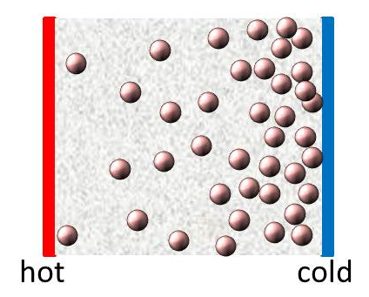
Thermodiffusion

Slide 4
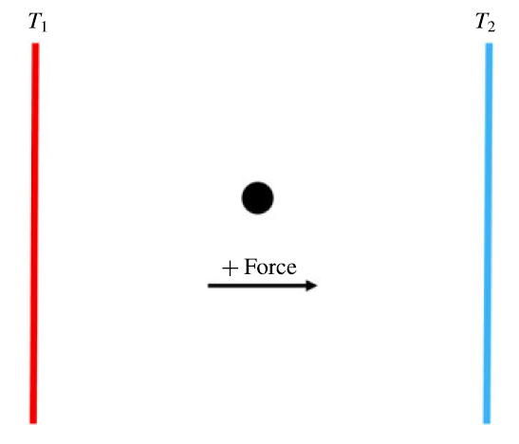
Thermophoresis

Slide 5
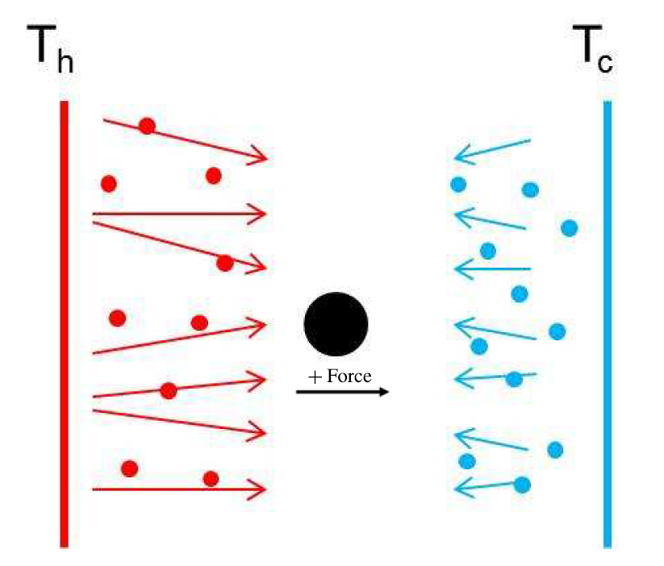
Thermophoresis

Slide 6
Negative thermophoresis
Colloids
Polymers
Charged nanopartcles
Magnetic particles
Fullerenes
Proteins
Vesicles
Force

Slide 7
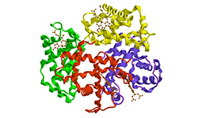
Negative thermophoresis
Force

Slide 8
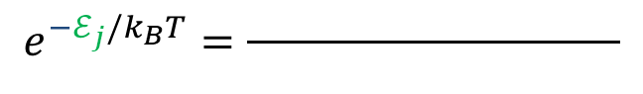

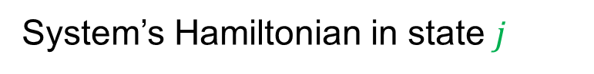
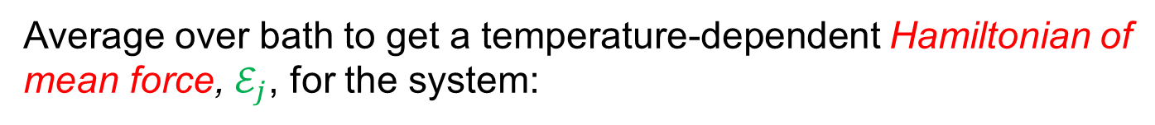

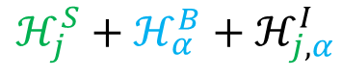
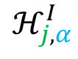
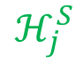
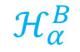
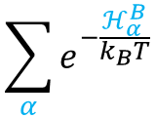

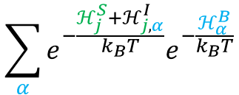

Strong coupling
System’s Hamiltonian in state $j$
$α$
$$ℋ_{j}^{S}$$
$$j$$
$$j$$
Bath’s Hamiltonian in state $α$
$$ℋ_{α}^{B}$$
Interaction system-bath
$$ℋ_{j,α}^{I}$$
Total Hamiltonian
$$ℋ_{j}^{S}+ℋ_{α}^{B}+ℋ_{j,α}^{I}$$
Average over bath to get a temperature-dependent Hamiltonian of mean force, $ℰ_{j}$, for the system:
$$\sum_{α}{e^{−\frac{ℋ_{j}^{S}+ℋ_{j,α}^{I}}{k_{B}T}}e^{−\frac{ℋ_{α}^{B}}{k_{B}T}}}$$
$$e^{{−ℰ}_{j}/k_{B}T}=\frac{ }{ }$$
$$\sum_{α}{e^{−\frac{ℋ_{α}^{B}}{k_{B}T}}}$$
Talkner, P.; Hanggi, P. Phys. Rev. E 2016, 94, 022143.

Slide 9
Strong coupling
System’s Hamiltonian in state $j$
$α$
$$ℋ_{j}^{S}$$
$$j$$
Bath’s Hamiltonian in state $α$
$$ℋ_{α}^{B}$$
Total Hamiltonian
$$ℋ_{j}^{S}+ℋ_{α}^{B}+ℋ_{j,α}^{I}$$
Average over bath to get a temperature-dependent Hamiltonian of mean force, $ℰ_{j}$, for the system:
$$\sum_{α}{e^{−\frac{ℋ_{j}^{S}+ℋ_{j,α}^{I}}{k_{B}T}}e^{−\frac{ℋ_{α}^{B}}{k_{B}T}}}$$
$$e^{{−ℰ}_{j}/k_{B}T}=\frac{ }{ }$$
$$\sum_{α}{e^{−\frac{ℋ_{α}^{B}}{k_{B}T}}}$$

Slide 10
Strong coupling
System’s Hamiltonian in state $j$
$α$
$$ℋ_{j}^{S}$$
$$j$$
$$j$$
Bath’s Hamiltonian in state $α$
$$ℋ_{α}^{B}$$
Interaction system-bath
$$ℋ_{j,α}^{I}$$
Total Hamiltonian
$$ℋ_{j}^{S}+ℋ_{α}^{B}+ℋ_{j,α}^{I}$$
Average over bath to get a temperature-dependent Hamiltonian of mean force, $ℰ_{j}$, for the system:
$$\sum_{α}{e^{−\frac{ℋ_{j}^{S}+ℋ_{j,α}^{I}}{k_{B}T}}e^{−\frac{ℋ_{α}^{B}}{k_{B}T}}}$$
$$e^{{−ℰ}_{j}/k_{B}T}=\frac{ }{ }$$
$$\sum_{α}{e^{−\frac{ℋ_{α}^{B}}{k_{B}T}}}$$

Slide 11
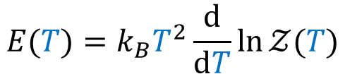
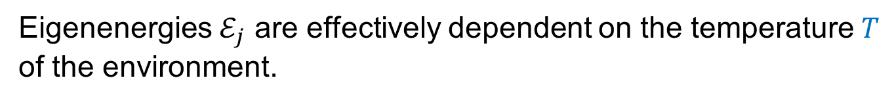
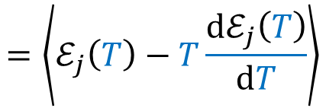
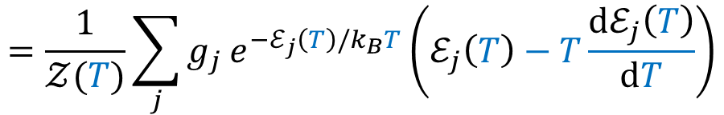
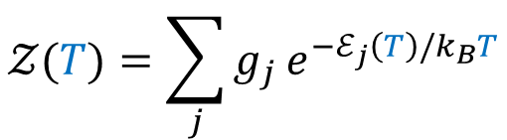
Strong coupling
Eigenenergies $ℰ_{j}$ are effectively dependent on the temperature $T$ of the environment.
$$𝒵(T)=\sum_{j}{g_{j}}e^{−ℰ_{j}\left(T\right){/k}_{B}T}$$
Partition function
$$E(T)=k_{B}T^{2}\frac{d}{dT}\ln{𝒵(T)}$$
Energy
$$=\frac{1}{𝒵(T)}\sum_{j}{g_{j}}e^{−ℰ_{j}\left(T\right){/k}_{B}T}\left(ℰ_{j}\left(T\right)−T\frac{{dℰ}_{j}\left(T\right)}{dT}\right)$$
$$=\left\langle ℰ_{j}\left(T\right)−T\frac{{dℰ}_{j}\left(T\right)}{dT}\right\rangle$$
Elcock, E. W.; Landsberg P. T. Temperature Dependent Energy Levels in Statistical Mechanics. Proc. Phys. Soc., London, Sect B 1957, 70, 161-168.
Seifert, U. First and Second Law of Thermodynamics at Strong Coupling. Phys. Rev. Lett. 2016, 116, 020601.
Talkner, P.; Hanggi, P. Open system Trajectories specify fluctuating work but not heat. Phys. Rev. E 2016, 94, 022143.

Slide 12
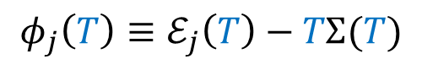
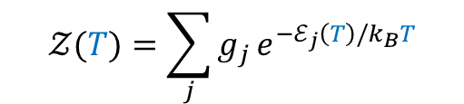
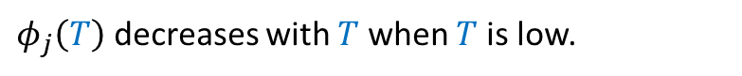
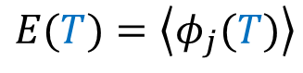
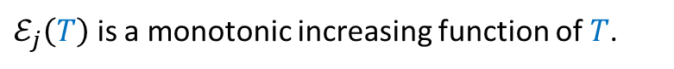
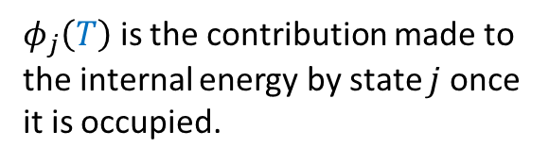
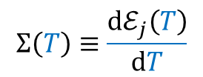
Strong coupling
$$E(T)=\left\langle φ_{j}(T)\right\rangle$$
$$Σ\left(T\right)≡\frac{{dℰ}_{j}\left(T\right)}{dT}$$
where
$$φ_{j}\left(T\right)≡ℰ_{j}\left(T\right)−TΣ(T)$$
$φ_{j}\left(T\right)$ is the contribution made to the internal energy by state $j$ once it is occupied.
$ℰ_{j}\left(T\right)$ gives the probability that state $j$ is occupied.
$$𝒵(T)=\sum_{j}{g_{j}}e^{−ℰ_{j}\left(T\right){/k}_{B}T}$$
$φ_{j}\left(T\right)$ decreases with $T$ when $T$ is low.
$ℰ_{j}\left(T\right)$ is a monotonic increasing function of $T$.
The effective energy profile $E(T)$ is a non-monotonic function of temperature.
Whitfield, G.; Engineer, M. Phys. Rev. B 1975, 12, 5472.

Slide 13
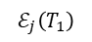
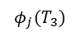
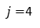
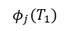
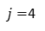
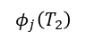
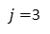
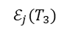
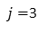
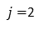
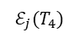
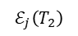
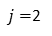
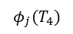
$j=$4
$$ℰ_{j}(T_{4})$$
COLD
$$ℰ_{j}(T_{3})$$
HOT
$j=$3
$$ℰ_{j}\left(T_{2}\right)$$
$j=$2
$$ℰ_{j}\left(T_{1}\right)$$
$$j=1$$
$$T_{1}$$
$$T_{2}$$
$$T_{3}$$
$$T_{4}$$
COLD
$j=$4
HOT
$j=$3
$$φ_{j}(T_{4})$$
$j=$2
$$φ_{j}(T_{1})$$
$$φ_{j}(T_{3})$$
$$j=1$$
$$φ_{j}\left(T_{2}\right)$$
$$T_{1}$$
$$T_{2}$$
$$T_{3}$$
$$T_{4}$$

Slide 14
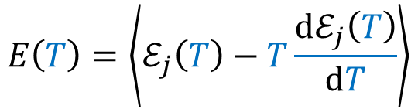
Internal energy?
$$E\left(T\right)=\left\langle ℰ_{j}\left(T\right)−T\frac{{dℰ}_{j}\left(T\right)}{dT}\right\rangle$$
The internal energy
is a nonmonotonic function of temperature.
Negative heat capacity ?
Unstable??

Slide 15

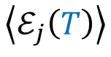


Free energy
Free energy of solvation
free
$$E\left(T\right)=\left\langle ℰ_{j}\left(T\right)−T\frac{{dℰ}_{j}\left(T\right)}{dT}\right\rangle$$
$α$
The internal energy
$$j$$
$$j$$
is a nonmonotonic function of temperature.
The internal energy
$$\left\langle ℰ_{j}\left(T\right)\right\rangle$$
is still a monotonically increasing function of $T$.
Positive heat capacity.
Stable.

Slide 16
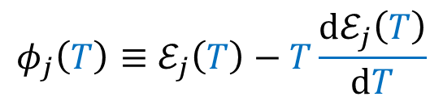
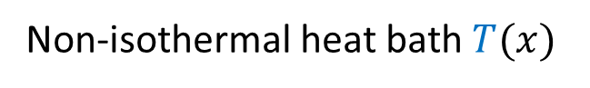
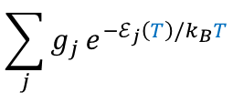
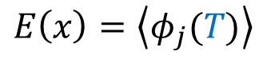
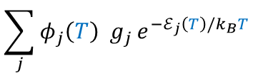
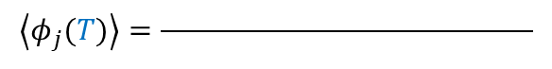
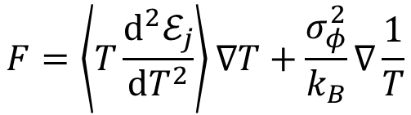
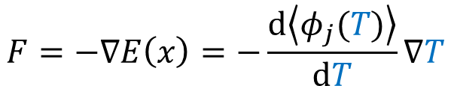
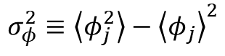
Thermophoretic force
Non-isothermal heat bath $T(x)$
$$φ_{j}\left(T\right)≡ℰ_{j}\left(T\right)−T\frac{{dℰ}_{j}\left(T\right)}{dT}$$
Free energy
$$E\left(x\right)=\left\langle φ_{j}(T)\right\rangle$$
with
$$F=−∇E\left(x\right)=−\frac{d\left\langle φ_{j}(T)\right\rangle }{dT}∇T$$
Thermophoretic force
$$\sum_{j}{φ_{j}\left(T\right) g_{j}}e^{−ℰ_{j}\left(T\right)/k_{B}T}$$
where
$$\left\langle φ_{j}(T)\right\rangle =\frac{ }{ }$$
$$\sum_{j}{g_{j}}e^{−ℰ_{j}\left(T\right)/k_{B}T}$$
$$F=\left\langle T\frac{d^{2}ℰ_{j}}{dT^{2}}\right\rangle ∇T+\frac{σ_{φ}^{2}}{k_{B}}∇\frac{1}{T}$$
results in
with
$$σ_{φ}^{2}≡\left\langle φ_{j}^{2}\right\rangle −{\left\langle φ_{j}\right\rangle }^{2}$$

Slide 17



Thermophoretic force
$$F=\left\langle T\frac{d^{2}ℰ_{j}}{dT^{2}}\right\rangle ∇T+\frac{σ_{φ}^{2}}{k_{B}}∇\frac{1}{T}$$
thermophilic
thermophobic
High temperature:
Energy becomes a linearized function of the temperature and $\frac{d^{2}ℰ_{j}}{dT^{2}}→0$.
Thermal fluctuations $σ_{φ}^{2}$ scale as $\sim c\left(T\right) T^{2}$.
Thermophobic term dominates: Positive thermophoresis.
Lower temperature:
Thermal fluctuations${ σ}_{φ}^{2}$ tend to vanish. Second term shrinks.
As the populated energy levels $ℰ_{j}(T)$ come close to their minimum value, $\frac{d^{2}ℰ_{j}}{dT^{2}}$ becomes more and more positive.
The first term, albeit small, may become significant.
At sufficiently low (system specific) $T$, first term is largest: Negative thermophoresis.

Slide 18

Thermophoretic force
$$F=\left\langle T\frac{d^{2}ℰ_{j}}{dT^{2}}\right\rangle ∇T+\frac{σ_{φ}^{2}}{k_{B}}∇\frac{1}{T}$$
thermophilic
thermophobic

Slide 19
Thermophoretic force
$$F=\left\langle T\frac{d^{2}ℰ_{j}}{dT^{2}}\right\rangle ∇T+\frac{σ_{φ}^{2}}{k_{B}}∇\frac{1}{T}$$
thermophilic
thermophobic
Experiments do show thermophobic motion at high temperatures and thermophillic motion at low temperatures.
Putnam, S. A. et al. Temperature Dependence of Thermodiffusion in Aqueous Suspensions of Charged Nanoparticles. Langmuir 2007, 23, 9221.
Iacopini S.; Piazza, R. Thermophoresis in protein solutions. Europhys. Lett. 2003, 63, 247.
Talbot, E. L. et al. Thermophoretic migration of vesicles depends on mean temperature and head group chemistry. Natur. Comm. 2017, 8, 15351.
Rita, R. et al. Thermally induced sign change of Soret coefficient for dilute and semidilute solutions of poly(N-isopropylacrylamide) in ethanol. J. Chem. Phys. 2004, 121, 9140.
Sugaya, R. et al. Thermal Diffusion of Dextran in Aqueous Solutions in the Absence and the Presence of Urea. Biomacromolecules 2006, 7, 435.

Slide 20
Reversal temperature
Polystyrene particles: 20º C
[Langmuir 23, 9221 (2007)]
Ionic micelles: 4ºC
[Eur. Phys. J. E 19, 59 (2006)]
Lysozome proteins: ~20ºC
[Langmuir 23, 9221 (2007); Eur. Phys. J. E 19, 59 (2006); Europhys. Lett. 63, 247 (2003)]
Dextran: 45ºC
[Biomacromolecules 7,435 (2006)]
Vesicles: 10ºC - 50ºC
[Nat. Commun. 8, 15351 (2017)]
Poly(N-isopropylacrylamide) in ethanol: 34ºC
[J. Chem. Phys. 121, 9140 (2004)]
Force

Slide 21


Electronic structure calculation: Glycine in water
Proteinogenic aminoacid

Slide 22


Electronic structure calculation: Glycine in water
Low T
Hight T

Slide 23

Electronic structure calculation: Glycine in water

Slide 24




Electronic structure calculation: Glycine
Low T: Implicit water solvent with explicit water
$ν=1732 cm^{−1}$
High T: Implicit water solvent
$ν=1663 cm^{−1}$

Slide 25
Model: Harmonic oscillator coupled to the heat bath
Proteins may be modelled as a set of harmonic oscillators [Protein Sci. 14, 633 (2005)].
Models have been proposed to treat the heat bath as a large collection of oscillators coupled to the particle in solution [Phys. Rep. 168, 115 (1988), Stoch. Dyn. 02, 533 (2002)].
Coupling between oscillators occurs when they are allowed to interact and exchange energy.
The spectrum of the system is then modified into vibrational frequencies that differ from the original oscillator modes [Rep. Prog. Phys. 78, 013901 (2015)].
Weak coupling: frequency modifications negligible.
Strong coupling: frequency modifications significant.

Slide 26




Model: Harmonic oscillator coupled to the heat bath
Harmonic oscillator: $j$ energy units of size $ℏω$
Strongly coupled to the oscillators in the heat bath.
Energy exchange is regulated by the heat bath temperature $T.$
Frequency becomes temperature dependent:
Partition function
Energy
$$ℰ_{j}\left(T\right)=\left(j+1/2\right)ℏω(T)$$
$$𝒵(T)=\sum_{j=0}^{∞}{e^{−\left(j+1/2\right)ℏω(T)/k_{B}T}}$$
$$E\left(T\right)=k_{B}T^{2}\frac{d}{dT}\ln{𝒵\left(T\right)}=\frac{1}{2}\coth\left(\frac{ℏω(T)}{2k_{B}T}\right)ℏ\left[ω(T)−Tω′(T) \right]$$

Slide 27





Model: Harmonic oscillator coupled to the heat bath
Temperature-dependent
frequency
$$ω\left(T\right)=$$
$$ω_{0}$$
$$e^{−αT}$$
Then, the energy function
$$E\left(T\right)=k_{B}T^{2}\frac{d}{dT}\ln{𝒵\left(T\right)}=\frac{1}{2}\coth\left(\frac{ℏω(T)}{2k_{B}T}\right)ℏ\left[ω(T)−Tω′(T) \right]$$
has one and only one minimum at a positive temperature $T=T^{∗}$.
Reversal temperature.
Nummerical example: $ω_{0}={10}^{15}Hz$, $α=1/120K$,
then the reversal temperature is $T^{∗}={24}^{o}C$.

Slide 28
Some applications of negative thermophoresis
Drug delivery
Local heating is easier than local cooling
Guide self-propelled particles towards locally heated targets
Force
Baylis, J. R. et al. Halting hemorrhage with self-propelling particles and local drug delivery. Thromb. Res. 2016, 141, S36.
Capture of DNA and other biological indicators in serum
Detection of small quantities unachievable in thermally homogeneous samples
Yu, L.-H.; Chen, Y.-F.;. Concentration-dependent thermophoretic accumulation for the detection of DNA using DNA-functionalized nanoparticles. Annal. Chem. 2015, 87, 2845.
Origin of life?
Thermophilic accumulation of lipids and nucleic acids
Self assembly of nucleic acids and protocells
Niether, D. et al. Accumulation of formamide in hydrothermal pores to form prebiotic nucleobases. Proc. Natl. Acad. Sci. USA 2016, 113, 4272.
Budin, I. et al. Formation of Protocell-like Vesicles in a Thermal Diffusion Column. J. Am. Chem. Soc. 2009, 131, 9628.

Slide 29


Conclusion
Negative thermophoretic force results from strong coupling.
Effective macrostate energies $ℰ_{j}$ become temperature-dependent
$E=k_{B}T^{2}\frac{d}{dT}\ln{𝒵}=\left\langle ℰ_{j}−T\frac{{dℰ}_{j}}{dT}\right\rangle$ is a free energy of solvation
$dE=d\left\langle ℰ_{j}\right\rangle −d\left\langle T\frac{{dℰ}_{j}}{dT}\right\rangle$
Potential energy surface changes.
Vibrational frequencies depend on the temparature of the solvent.
Temperature-dependence of effective energy profile $E(T)$ is nonmonotonic
The sign of the force function $dE/dT$ becomes temperature dependent.
Thermostatistical description of negative thermophoresis
the system takes heat +$d\left\langle ℰ_{j}\right\rangle$ from the environment
and returns work $−d\left\langle T{dℰ}_{j}/dT\right\rangle$ to the environment.

Slide 30
Thank you
More info: Physical Review Letters 123, 200602 (2019)
https://journals.aps.org/prl/pdf/10.1103/PhysRevLett.123.200602
www.ntnu.edu

